Slide 1
JRC Quantum Inter-directorate Working Group
Made up of 16+ individuals from all 8 scientific directorates, led by directorates E and T
Multi-disciplinary perspective on quantum and quantum technologies at the JRC.
Research and scientific organisation focused – not only JRC.
Deliverable 1: Outlook Report on Quantum
Deliverable 2: Detailed Implementation Plan
Deliverable 3: Federated Quantum Lab

Slide 2
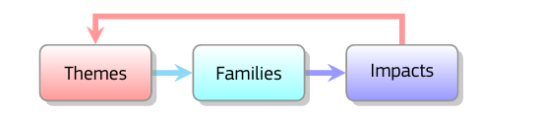
Quantum Outlook Methodology
Collaborative, structured, cross-disciplinary inquiry within the JRC.
Identification of potential quantum technologies applications by each Directorate.
Unique science-for-policy focus on the topic.
Assessment of the relevant scientific domains and themes covered by the organisation.
Developments of these thematic areas across three key families of quantum technologies.
Link to broader impacts, including considerations related to strategic autonomy.

Slide 3

Quantum Outlook Report
Artist Libby Heaney’s Growler series (2024) explores superposition Sculpting glass into​ forms that appear simultaneously solid and slimy creates a tactile encounter with the concept of in-​ betweenness.
Introduction
2. Research Use Cases using Quantum Technologies
-Theme 1
.Sensing
.Communication
.Computing
.(Other considerations)
-Theme 2
3. Strategic positioning
4. Conclusion
Themes:
-Artificial Intelligence
-Climate
-Cybersecurity
-Earth Observation
-Economy and Finance
-Energy
-Health
-Law Enforcement
-Nuclear
-Social Sciences
-Space systems, Navigation and Communications
-Transports

Slide 4
Quantum Outlook Key Messages
Key message 1: Quantum technology has potential for numerous research applications of direct interest for European public policy.
Key message 2: Some scientific domains will develop the quantum technology itself, but most will benefit from it.
.
Key message 3: Quantum technologies have different readiness levels and thus require operating on multiple policy adoption horizons.
Key message 4 : One EU sovereign challenge is the EU’s capacity to independently test, benchmark, vali date and certify quantum systems. This requires more than producing hardware or supporting companies.
Key message 5 :Research institutions should anticipate quantum capabilities before the technology is operational. This includes building up quantum-readiness through skills, infrastructure, and collaborations to boost future adoption and development.

Slide 5
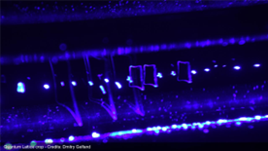
Quantum Outlook for Policymakers
Intended audience is scientific community and interested policymakers potentially useful for DG CNECT to inform the Quantum Act
Concrete use case tables for each theme
Added text boxes to explain more technical and abstract concepts
Towards understanding quantum via art
Section on strategic positioning
Evelina Domnitch and Dmitry Gelfand's Quantum Lattice hollow glass microspheres make trapped particle dynamics directly visible

